Slide 1

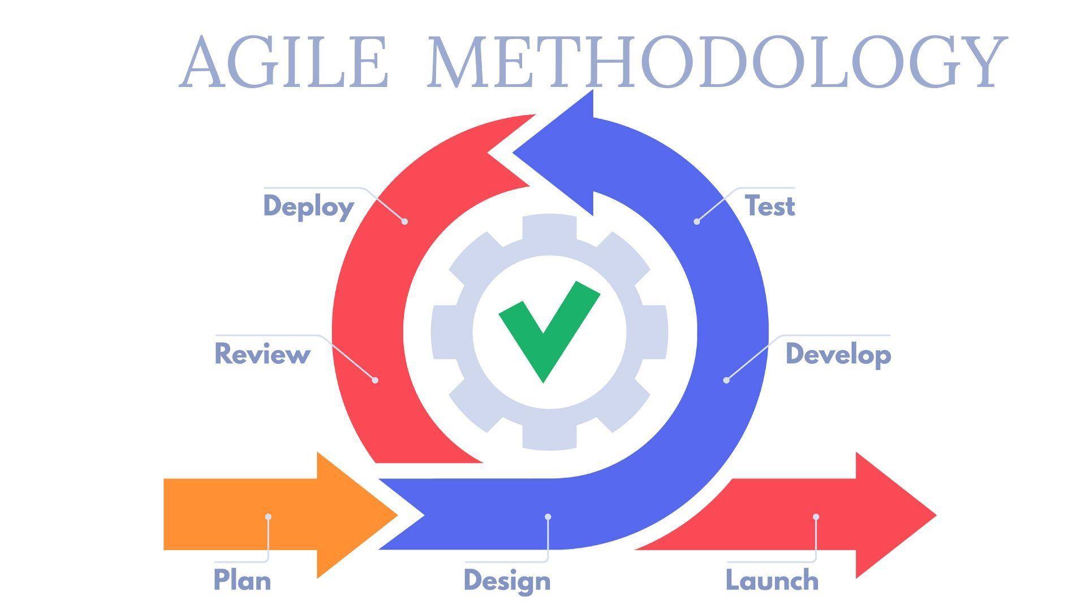
AGILE METHODOLOGY
The Agile methodology is a way to manage a project by breaking it up into several phases. It involves constant collaboration with stakeholders and continuous improvement at every stage. Once the work begins, teams cycle through a process of planning, executing, and evaluating.

Slide 2
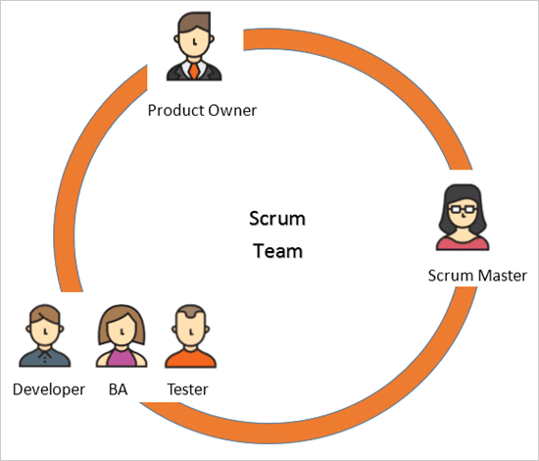
Roles in Agile Methodology:
There are 3 main roles in Agile methodology . They are:
Scrum Master
Product Owner
Team Member
The Product Owner – Often an executive or key stakeholder, the Product Owner has a vision for the end product and a sense of how it will fit into the company’s long-term goals. This person will need to direct communication efforts, alerting the team to major developments and stepping in to course-correct and implement high-level changes as necessary.

Slide 3
The Scrum Master – The Scrum Master is most akin to a project manager. They are guardians of process, givers of feedback, and mentors to junior team members. They oversee day-to-day functions, maintain the Scrum board, check in with team members, and make sure tasks are being completed on target.
The Team Member – Team members are the makers: front- and back-end engineers, copywriters, designers, videographers, you name it. Team members have varied roles and skills but all are responsible for getting stuff done on time and in excellent quality.

Slide 4
Advantages Of Agile Methodology
Superior quality product.
Customer satisfaction.
Better control.
Improved project predictability
.
Reduced risks.
Increased flexibility.
Continuous improvement

Slide 5
Customer satisfaction is rapid, continuous development and delivery of useful software.
2.Customer, Developer, and Product Owner interact regularly to emphasize rather than processes and tools.
3.Product is developed fast and frequently delivered (weeks rather than months.)
4.A face-to-face conversation is the best form of communication.
5.It continuously gave attention to technical excellence and good design
6.Daily and close cooperation between business people and developers.
7.Regular adaptation to changing circumstances.
8.Even late changes in requirements are welcomed.

Slide 6
Disadvantages of Agile Methodology:
It is not useful for small development projects.
There is a lack of intensity on necessary designing and documentation.
It requires an expert project member to take crucial decisions in the meeting.
Cost of Agile development methodology is slightly more as compared to other development methodology.
The project can quickly go out off track if the project manager is not clear about requirements and what outcome he/she wants.

Slide 7
Principles Of Agile Methodology:
Customer Satisfaction
Welcome Charge
Deliver the Working Software Frequently
Collaboration
Motivation
Face to Face Conversation
Maintain Constant
Monitoring
Simplicity
Self Organised teams
Review the Work Reguraly

Slide 8
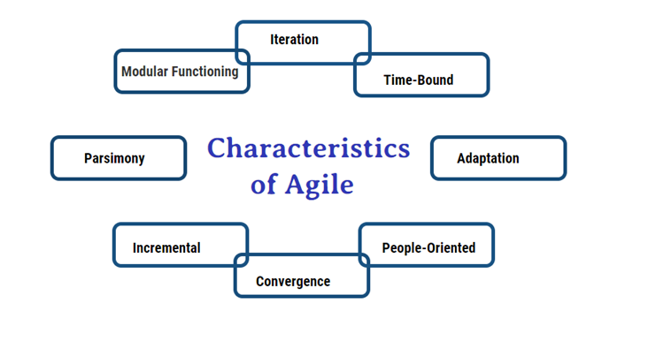
Characteristics Of Agile Methodology:

Slide 9
Characteristics of agile development success
Agile development releases and fixed-length iterations.
Agile development delivers working, tested software.
Value-driven development.
Continuous (adaptive) planning.
Multi-level planning in agile development.
Relative estimation.
Emergent feature discovery.
Continuous testing.

Slide 10
Extreme Programming:
Extreme Programming (XP) is an agile software development framework that aims to produce higher quality software, and higher quality of life for the development team. XP is the most specific of the agile frameworks regarding appropriate engineering practices for software development.

Slide 11
Values In Extreme Programming
Values
The five values of XP are communication, simplicity, feedback, courage, and respect and are described in more detail below.
Communication
Software development is inherently a team sport that relies on communication to transfer knowledge from one team member to everyone else on the team. XP stresses the importance of the appropriate kind of communication – face to face discussion with the aid of a white board or other drawing mechanism.
Simplicity
Simplicity means “what is the simplest thing that will work?” The purpose of this is to avoid waste and do only absolutely necessary things such as keep the design of the system as simple as possible so that it is easier to maintain, support, and revise. Simplicity also means address only the requirements that you know about; don’t try to predict the future.

Slide 12
Feedback
Through constant feedback about their previous efforts, teams can identify areas for improvement and revise their practices. Feedback also supports simple design. Your team builds something, gathers feedback on your design and implementation, and then adjust your product going forward.
Courage
Kent Beck defined courage as “effective action in the face of fear” (Extreme Programming Explained P. 20). This definition shows a preference for action based on other principles so that the results aren’t harmful to the team. You need courage to raise organizational issues that reduce your team’s effectiveness. You need courage to stop doing something that doesn’t work and try something else. You need courage to accept and act on feedback, even when

Slide 13
Principles Of Extreme Programming
Rapid feedback.
Assume simplicity.
Incremental change.
Embracing change.
Quality work.

Slide 14
KANBAN
Agile Kanban is Agile Software Development with Kanban approach. In Agile Kanban, the Kanban board is used to visualize the workflow. The Kanban board is normally put up on a wall in the project room. The status and progress of the story development tasks is tracked visually on the Kanban board with flowing Kanban cards.
It is a popular framework used to implement agile and DevOps software development. It requires real-time communication of capacity and full transparency of work. Work items are represented visually on a kanban board, allowing team members to see the state of every piece of work at any time.

Slide 15
PPrinciples Of Kanban
Start with what you do now
Agree to pursue incremental, evolutionary change
Respect the current process, roles, responsibilities, and titles
Encourage acts of leadership at all levels in your organization

Slide 16


